Slide 1
Eric M. Fink
November 7, 2014
Notes:
Click to edit the notes format

Slide 2
Federal Trade Commission Act
Unfair methods of competition in or affecting commerce, and unfair or deceptive acts or practices in or affecting commerce, are hereby declared unlawful.
Notes:
Click to edit the notes format

Slide 3
NJ Consumer Fraud Act
[A]ny unconscionable commercial practice, deception, fraud, false pretense, false promise, misrepresentation, or the knowing, concealment, suppression, or omission of any material fact with intent that others rely upon such concealment, suppression or omission, in connection with the sale or advertisement of any merchandise or real estate, … whether or not any person has in fact been misled, deceived or damaged thereby, is declared to be an unlawful practice.
Notes:
Click to edit the notes format

Slide 4
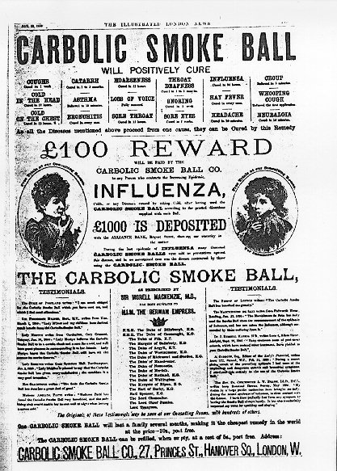
Blowing Smoke
Notes:
Click to edit the notes format

Slide 5

Flight of Fancy
Pepsi Ad
Notes:
Click to edit the notes format

Slide 6
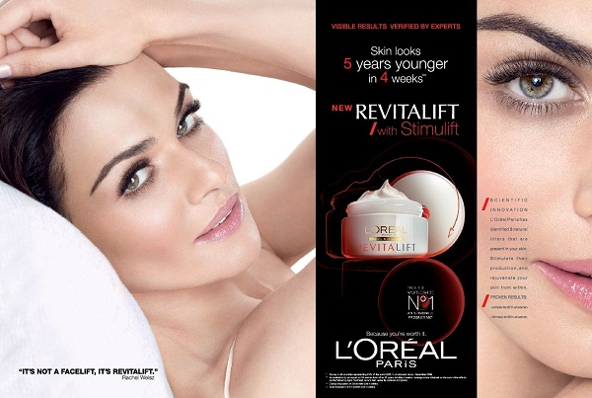
Cover Girl Cover Up
Notes:
Click to edit the notes format

Slide 7
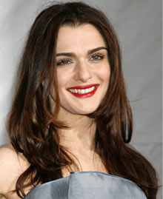
Cover Girl Cover Up
Notes:
Click to edit the notes format

Slide 8
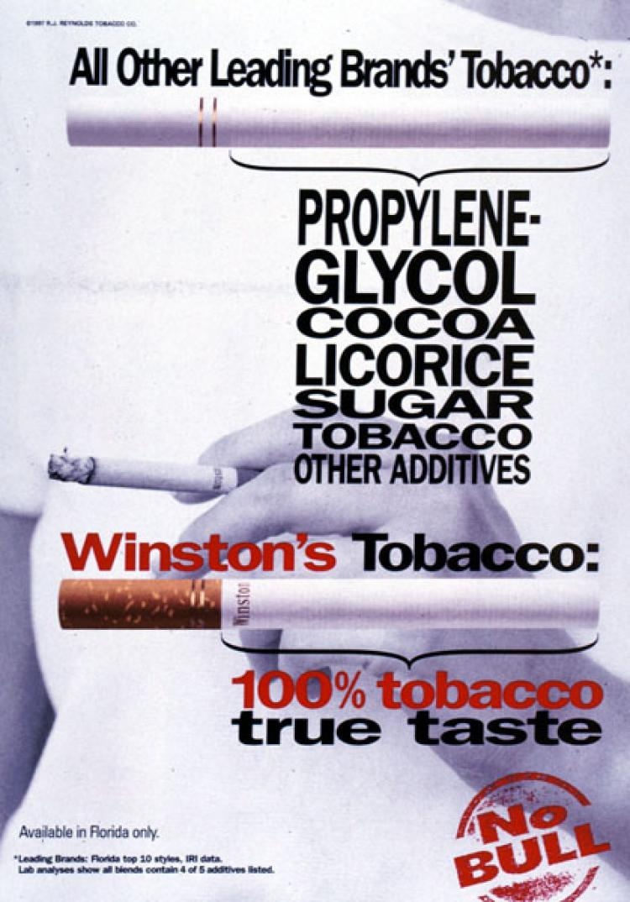
Blowing Smoke II
Notes:
Click to edit the notes format

